Slide 1

Connecting community banks in rural areas to Mexican and global payment networks

Slide 2
Who are we?
We’re creating a Clearinghouse based on AMUCSS’ current operating network of 140 community banks (mainly rural SOFINCOS & SOCAPS)
The Clearinghouse will provide inclusive financial technology to that network, in order to connect it to SPEI and other networks
And will provide a fast, cheap entry point for remittances to communities
So that liquidity can become savings and be reinvested in the community.
SPEI = Interbank electronic payment system. It is the real-time gross-settlement payment system of the Bank of Mexico, which has less than 100 participants, mainly commercial banks.

Slide 3
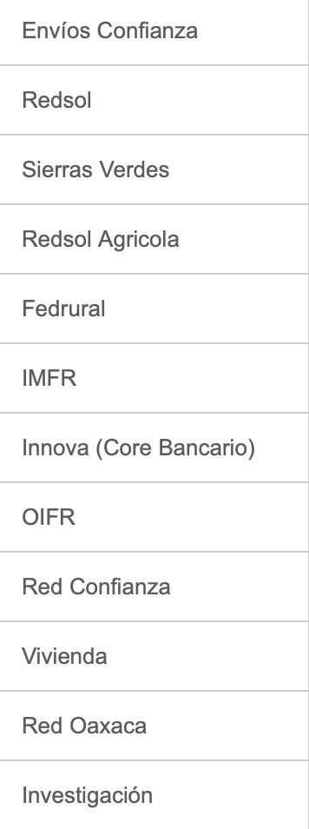
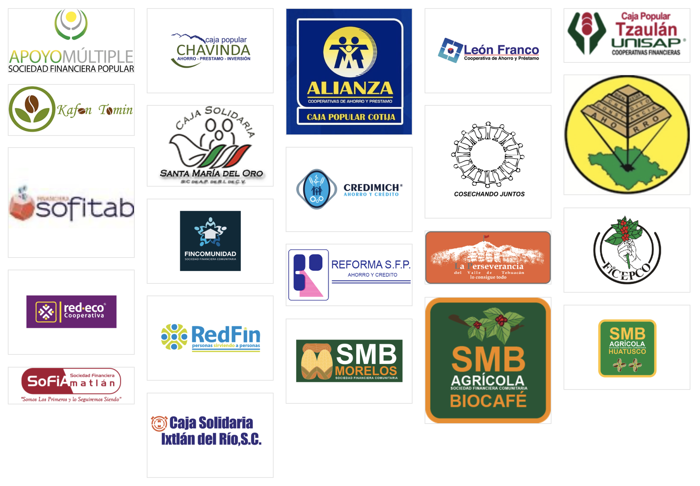
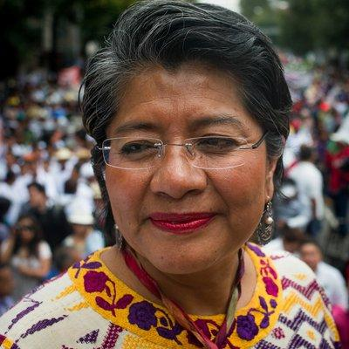
Our Leading Organization
The Mexican Association of Credit Unions of the Social Sector (AMUCSS) is a non-profit community-banks-owned organization
It assists small marginal communities, helping create local community bank.
Its network includes 140 community banks led by local organizations
Isabel Cruz - CEO

Slide 4
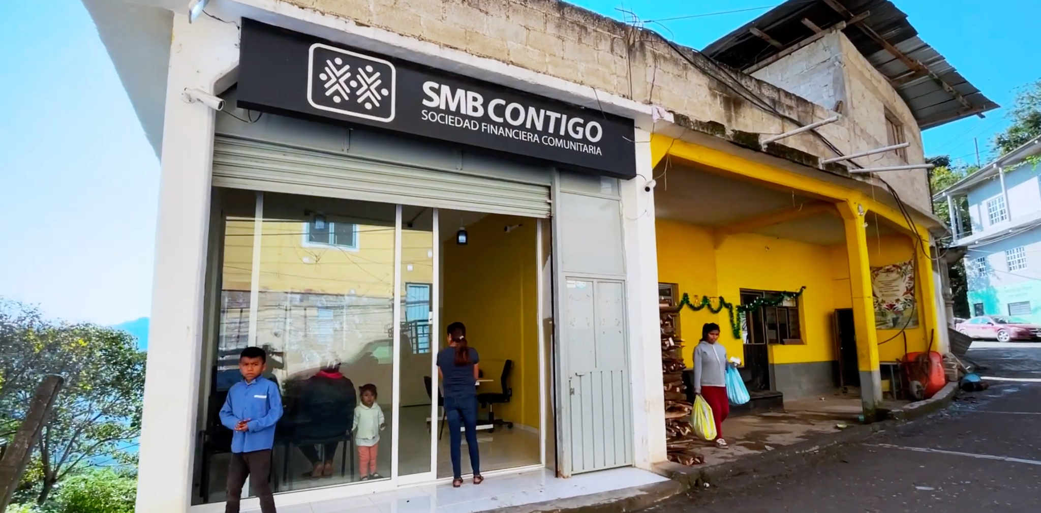
SMB Contigo in San Pablito, Puebla
Small community bank in an Otomí region
34 indigenous languages spoken in our community banks

Slide 5
Welcome to Mexico
BANXICO
Bank of Mexico
?
Bank 1
Commercial Bank
SOCAP*
SOFIPO*
SOFINCO*
Client
Client
Savings Coop
Community Bank
Rural Comm. Bank
Physical Person
Business
The network leaves out community banks, which have access only to very expensive options
MFI Client
MFI Client
Physical Person
Small Business

Slide 6
The People’s Clearinghouse Solution
BANXICO
Bank of Mexico
The People’s Clearinghouse
Bank
Mojaloop Clearinghouse
Commercial Bank
Indirect Participant 1
Indirect Participant 2
Indirect Participant 3
Client
Client
Savings’ Coop
Community Bank
Rural Comm. Bank
Physical Person
Business
It’s all about giving visibility to rural community banks and connecting them to the national banking network!
MFI Client
MFI Client
Physical Person
Small Business

Slide 7
The People’s Clearinghouse
Goal
Mojaloop Use Cases:
P2P
Towards a digital payment ecosystem
Cross-border transfers
Towards account remittances
Bulk transfer
Rural gov wages & social benefits
3PPI
App substitution for microbanks
Account remittances and a digital payment ecosystem will provide additional liquidity to community banks, which can then lend more to communities

Slide 8
So… back to the Proof-of-Concept:
Rafiki-enabled remittance flows

Slide 9
The real-world situation
We want to enable users of mobile wallets in the USA to transfer funds to customers of rural co-operative banks in Mexico.
Reminder: this is clearing funds. Settling happens elsewhere, though under our management.
We will use Rafiki to enable any mobile wallet in the USA to connect to the Mojaloop network via a Cross-Network Provider.
There is no FX conversion:
The Rafiki network will transact in USD
The Mojaloop network will transact in MXN
Currency conversion will use rates quoted by the Central Bank of Mexico, and applied by the CNP

Slide 10
The People’s Clearinghouse Remittance Messaging Process (without settlement)
The People’s Clearinghouse
US Commercial
Mojaloop Hub
Bank
Wallet implementing Rafiki
Cross-Network Provider
Rafiki-Enabled & Mojaloop Participant
Remittance PoO
Remittance PoO
Remittance PoO
Community bank
Non-Bank
Money Transmitter
Wallet Provider
Mojaloop Participant
Advances remittance to Client before settlement
Sender
Physical person
Client
Physical Person

Slide 11
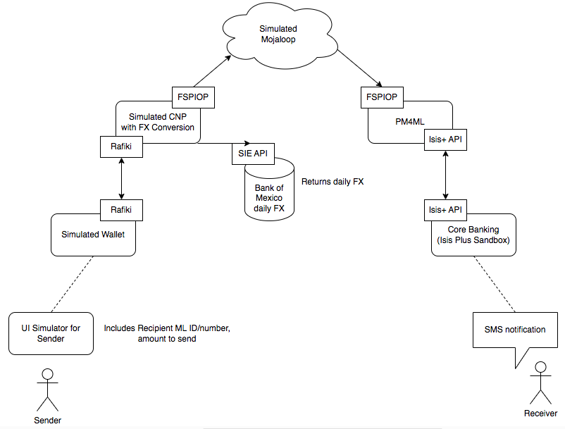
Proposed Demo
Rafiki for connecting external Wallets to the Scheme using the Interledger Protocol
A Cross-Network-Provider for calculating USD equivalent in Mexican pesos. This allows the Scheme to work only in pesos
A Mojaloop Scheme that validates accounts, prepares quotes and executes transfers
A Mojaloop Payment Manager that translates Mojaloop’s APIs into those of a Community Bank’s Core Banking
A Core Banking platform created by AMUCSS for its network’s community banks

Slide 12
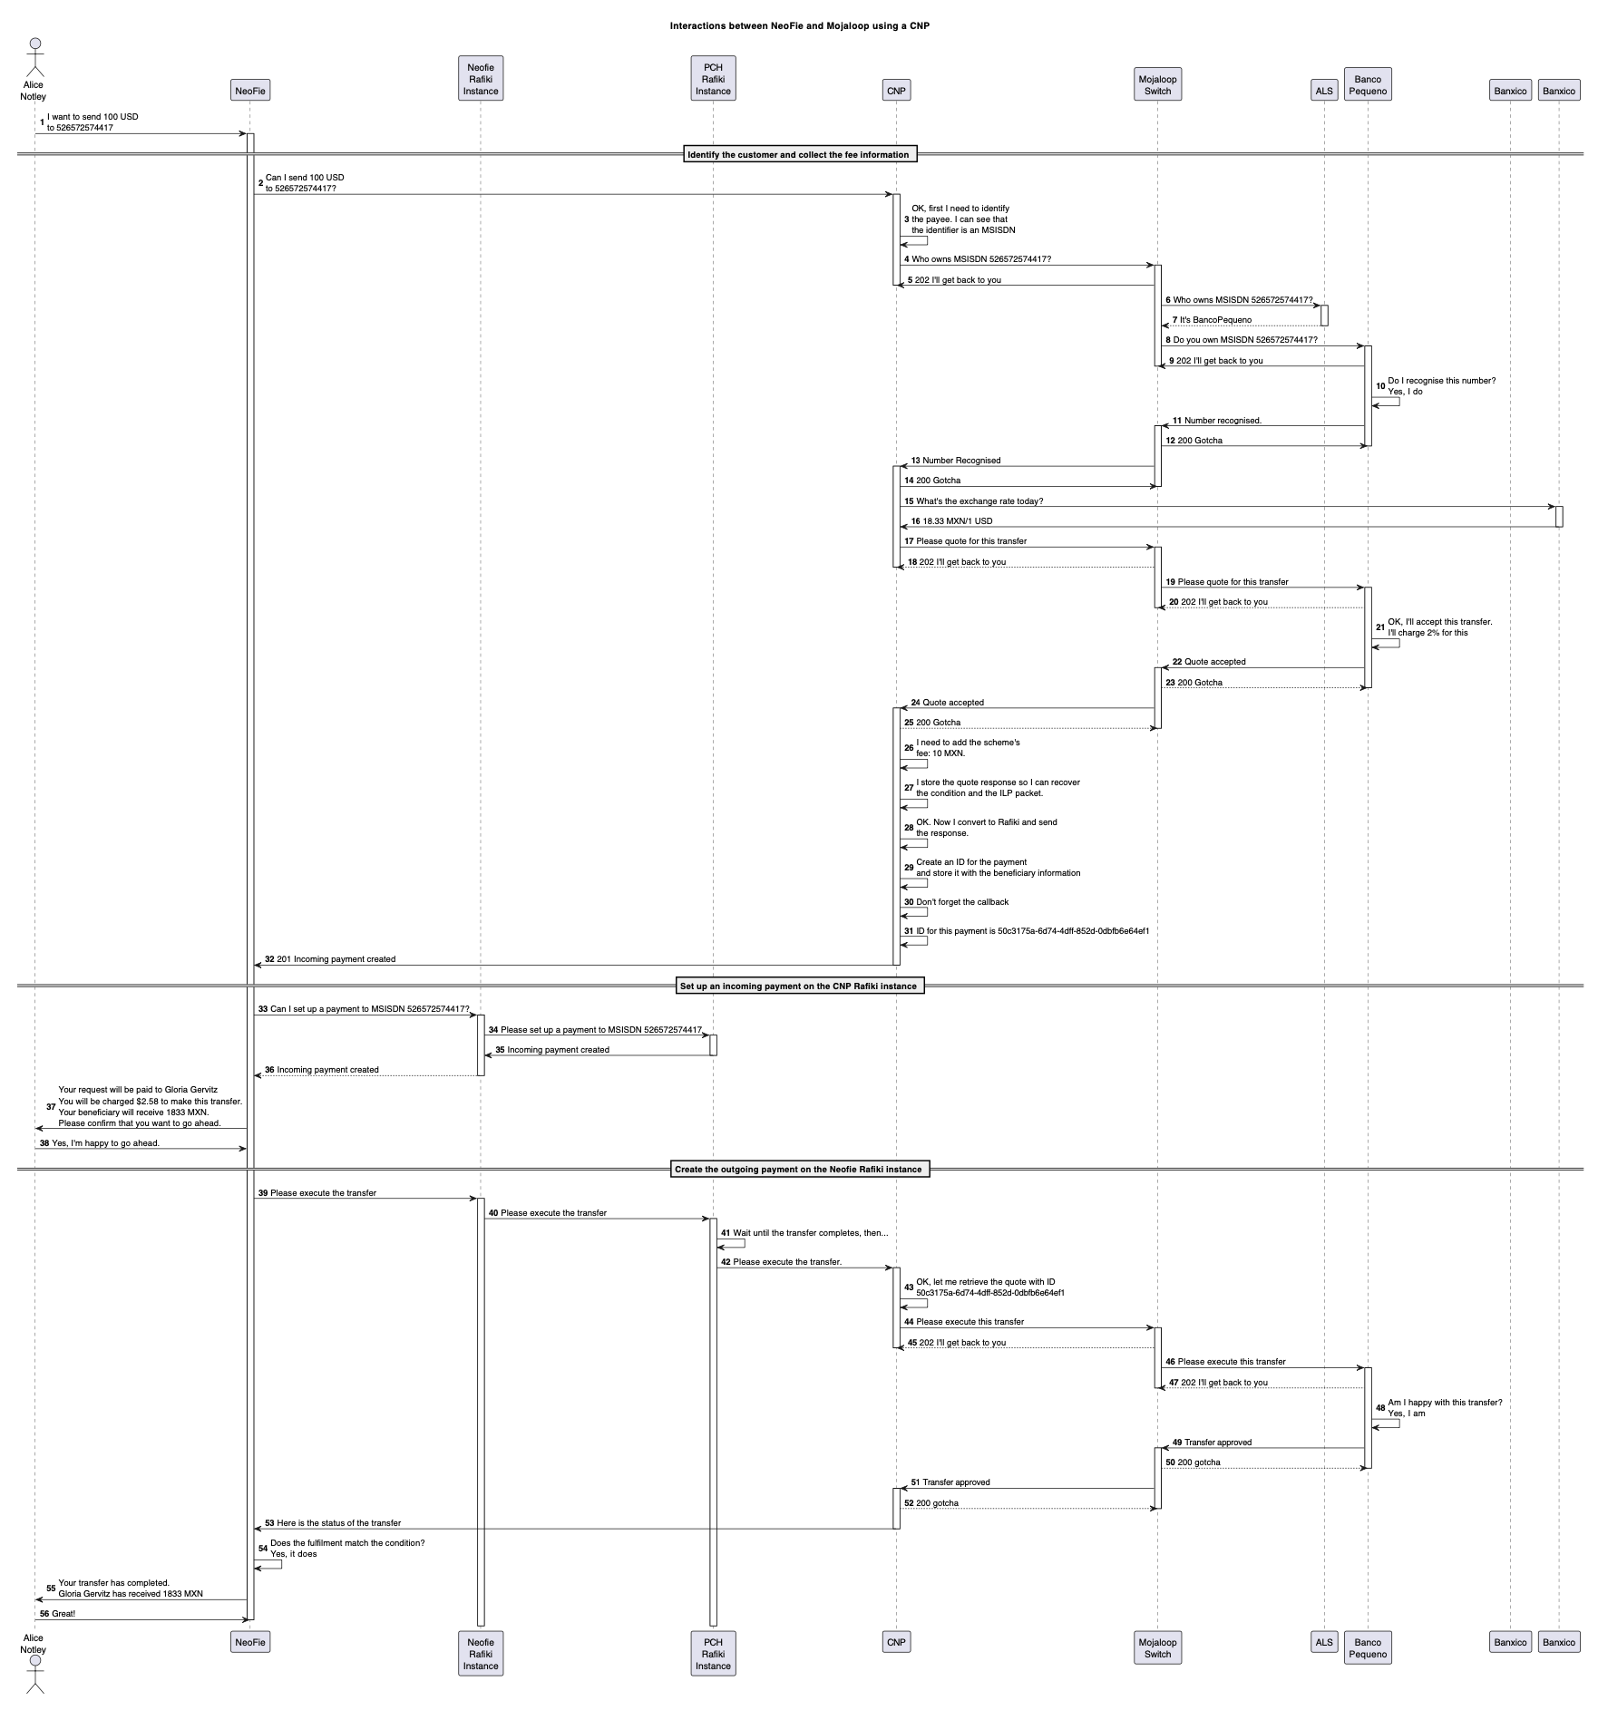
The Sequence Diagram
Sender
Wallet provider
Wallet Rafiki instance
PCH Rafiki instance
CNP
Mojaloop switch
Address Lookup Service
Community Bank
Banxico
Sequence Diagram in pdf
The PCH Rafiki Demo

Slide 13
Concluding

Slide 14


Account remittances
US-MX 2022 Remittances: most important source of income for many families
USD 58.5 billion with average $391/remittance
150 million remittances or 410,000/day
Remittances grow faster than FDI (in last 10 years: 56% vs. 19%)
But cash remittances can have pernicious effects: inflation, loss of production, inequality
Remittances arriving
directly into a
community bank’s account
Higher volume of local savings & investment
Thus, less inequality: all the community benefits from credit, not just those receiving remittances
Thus, more credit opportunities for local productive projects
Thus, more employment and local opportunities

Slide 15
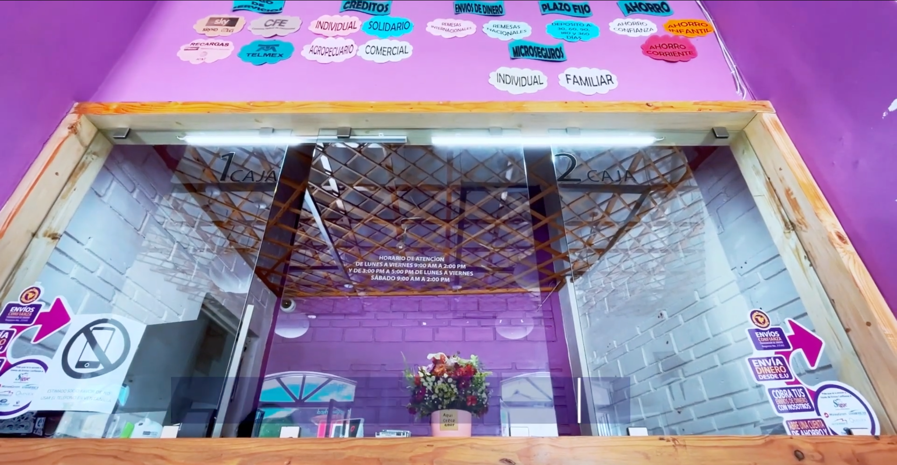
SMB Contigo in San Pablito, Puebla

Slide 16



Thank you!
Website:
lacamara.mx
Email:
aa@lacamara.mx
rv@lacamara.mx

